Slide 1


BUILD SELF CONFIDENCE
SOUMMYAJIT PANDA
SR ELITE OF RENATUS WELLNESS

Slide 2


Slide 3
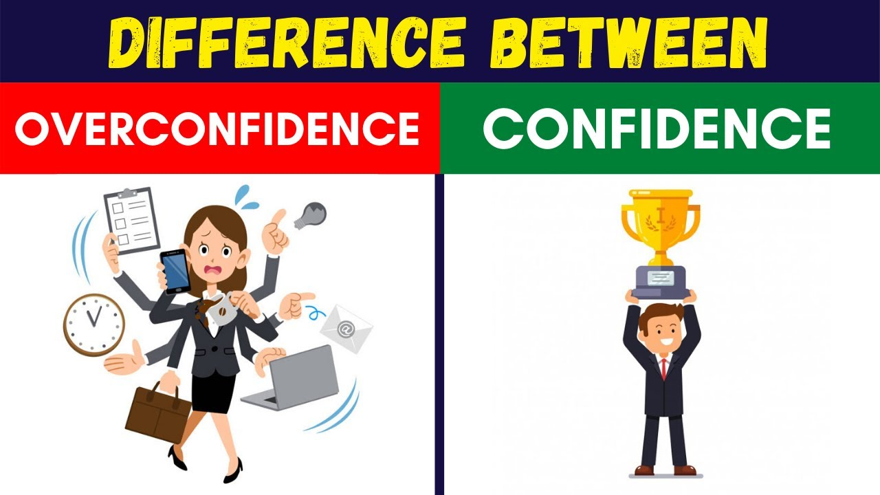
SELF CONFI

Slide 4
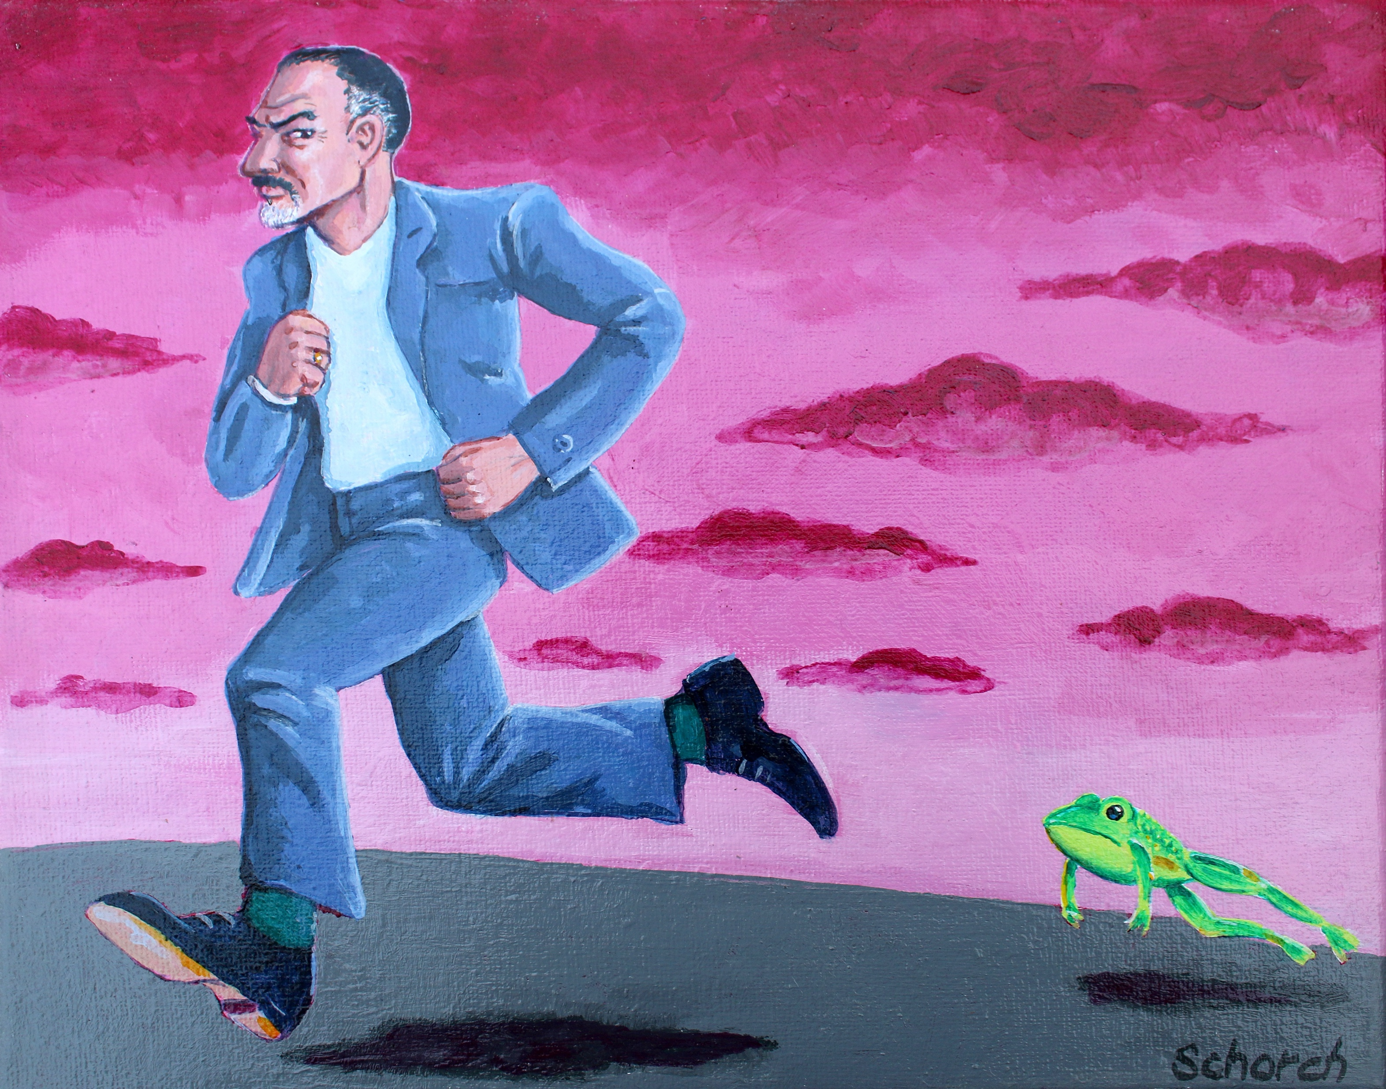
REMOVE FEAR AND SELFDOUTS.

Slide 5

HOW TO REMOVE SELF DOUTS.

Slide 6
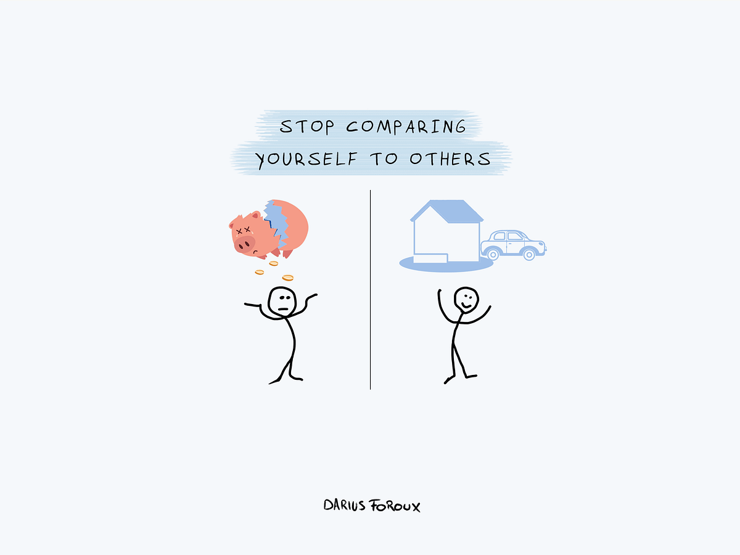
HOW TO REMOVE SELF DOUTS

Slide 7

RECOGNIZE NEGATIVE SELF- TALK
FOCUS ON THE PRESENT.

Slide 8


Slide 9
SELF- REFLECTION.
Identify strengths: Recognize your positive qualities, skills, and accomplishments.
Acknowledge weaknesses: Understand areas where you need improvement.
Set realistic goals: Break down large goals into smaller, achievable tasks.

Slide 10

PRACTICE MANIFASTATION
SET CLEAR INTENTIONS.
VISUALIZE.
AFFIRMATIONS.
TAKE ACTION.
MEDITATION.
VISION BOARDS.

Slide 11


Slide 12


Slide 13
TAKING ACTION
1. Take risks: Step out of your comfort zone and try new things.
2. Learn from failures: Use failures as opportunities for growth.
3. Celebrate successes: Acknowledge and celebrate your achievements.

Slide 14

BUILDING SKILLS. & KNOWLEDGE
1. Develop new skills: Acquire new skills or hobbies.
2. Seek feedback: Ask for constructive feedback from trusted sources.
3. Learn from others: Observe and learn from people who inspire you.

Slide 15
SELF- CARE
1. Practice self-compassion: Treat yourself with kindness and understanding.
2. Take care of your physical health: Exercise regularly, eat well, and get enough sleep.
3. Engage in activities you enjoy: Make time for hobbies and activities that bring you joy.

Slide 16

PASS THE TEST OF UNIVERSE.

Slide 17
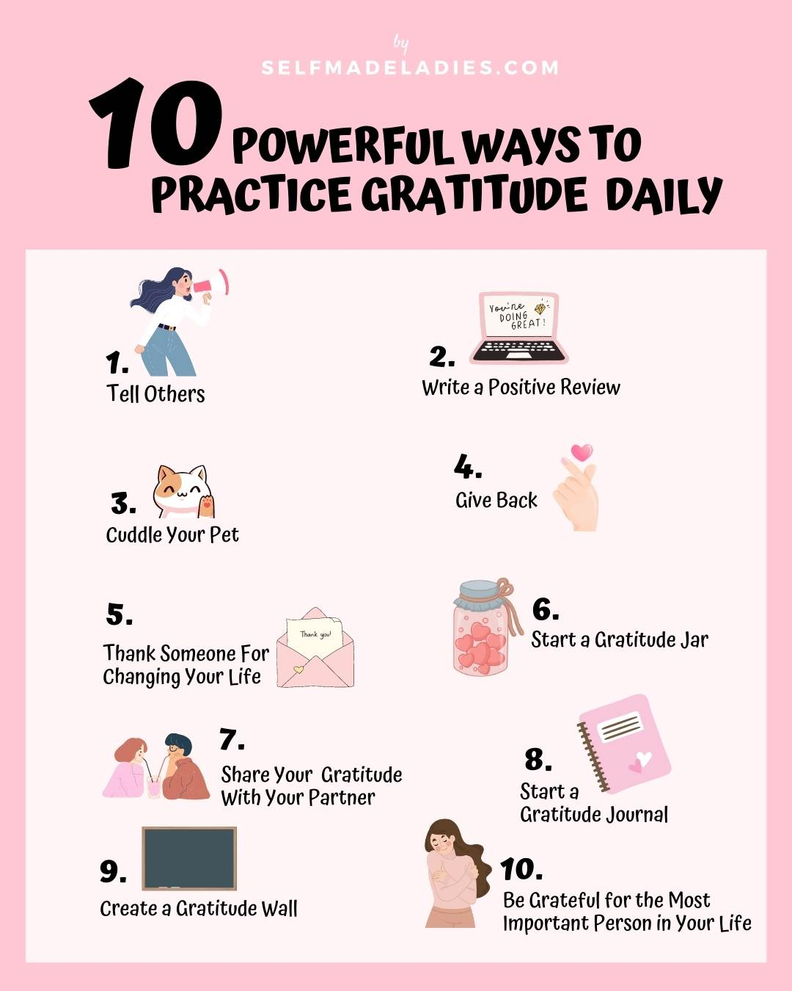
EXPRESS GRATITUDE

Slide 18

TRUST IN YOUR UNIVERSE.

Slide 19
Building self-confidence is a journey that takes time, effort, and patience. By practicing self-reflection, positive self-talk, taking action, building skills, and self-care, you can develop a more confident and positive self-image.

Slide 20


Slide 21



