Slide 1





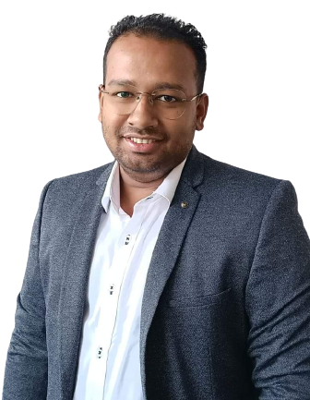


D E V E L O P M E N T
Success is a two way process. You work hard, you earn it.
JOIN NOW

Slide 2
W H O
A R E
Y O U ?
AN D W H Y A R E Y O U H E R E ?

Slide 3




Success in Network Marketing or Direct Selling Business often relies on a combination of strategies, skills, and personal qualities.

Slide 4



W H A T K I N D O F L I F E
D O Y O U W A N T ?
W H E N D O Y O U W A N T
T O A C H I E V E T H I S L I F E ?
W H A T O P T I O N S Y O U W I L L C H O O S E T O L I V E Y O U R D R E A M L I F E ?
D E C I S I O N

Slide 5
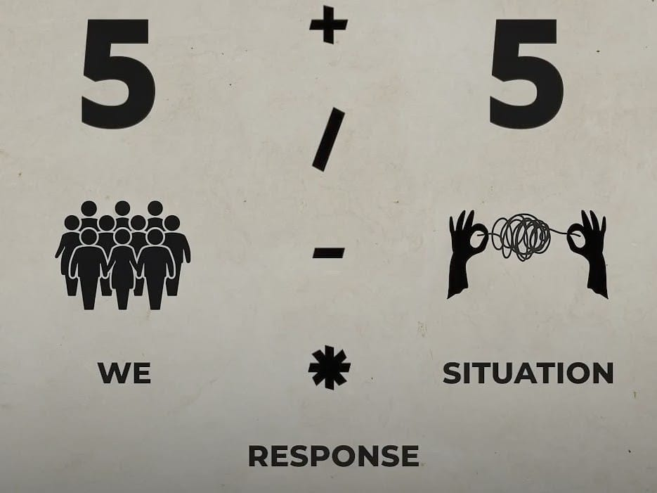

Slide 6


Commitment and Persistence
Understand that success takes time and effort.
Commit to a long-term vision and remain persistent even in the face of challenges.

Slide 7



Set Clear Goals
Define specific, measurable, and achievable goals for your business.
Break down your goals into smaller, actionable steps.

Slide 8






3 V
VITALIZE (PLANNING+ACTION)
(VERBALISE) (ANNOUNCE)
VISUALIZE (FEEL)

Slide 9



5 BASIC WORKS
1) List Building
2) Inviting
3) S T P (Show The Plan)
4) Follow Up / Feedback Session)
5) Closing

Slide 10


Effective Time Management
Prioritize tasks and allocate time for income-producing activities.
Avoid procrastination and stay organized.

Slide 11

Build Strong Relationships
Focus on building trust and rapport with your customers and team members.
Communication and relationship-building skills are critical.

Slide 12
6TH TRUTHS IN YOUR LIFE.
LOVE IS NOTHING WITH OUT ACTION.
TRUST IS NOTHING WITHOUT PROOF.
HOPE IS NOTHING WITHOUT EFFORT
GIVE IS NOTHING WITHOUT HEART.
SORRY IS NOTHING WITHOUT CHANGE.
LIFE IS NOTHING WITHOUT PEACE.

Slide 13


WORK WITH THE RIGHT PEOPLE.
HUNGER SURRENDER
INVEST YOUR ENERGY IN THE RIGHT PEOPLE
RIGHT PERSON FOR THE RIGHT JOB!

Slide 14


Effective Prospecting
Create a list of potential prospects and consistently reach out to them.
Use a variety of methods, including in-person meetings, social media, and referrals.

Slide 15

Effective Presentation
Develop compelling product or business presentations.
Tailor your presentations to the specific needs and interests of your audience.

Slide 16


Diversify Income Streams
Explore multiple avenues within the company's compensation plan.
Build a diverse customer base and team to increase income potential.

Slide 17

Celebrate Milestones
Acknowledge and celebrate your achievements, no matter how small.
Recognize and reward the accomplishments of your team members.
Notes:
Presented by: ………………….(Type your name) and in circle add your photo

Slide 18

Mental Toughness
Develop mental toughness to handle rejection and setbacks without losing motivation.
Use challenges as opportunities for growth.

Slide 19

Self-Reflection
Regularly assess your strengths and weaknesses.
Seek ways to improve and develop new skills.

Slide 20

Problem-Solving Skills
Develop strong problem-solving skills to overcome challenges.
Seek creative solutions to obstacles.

Slide 21

Personal Branding
Build a personal brand that aligns with your values and the company's image.
Be authentic and consistent in your branding efforts.

Slide 22

Advertise Your Success
Share your achievements and successes with your network.
Use your accomplishments as a testament to the opportunities in the industry.

Slide 23

Positive Self-Talk
Replace negative self-talk with positive affirmations.
Cultivate self-confidence and belief in your abilities.

Slide 24

Local Community Engagement
Get involved in local community events and activities.
Build a positive reputation within your community.

Slide 25

Celebrate Small Wins
Acknowledge and celebrate small achievements along the way.
Cultivate a positive and rewarding environment.

Slide 26


Slide 27
DEVLOPMENT LEADERSHIP SKILL.
BECOME EXCELENT.( NO BODY FOLLOW AVEARAGE PEOPLE)
DEVLOP THE ART OF OBSERVATION.
LEARN MORE THEN OTHHERS IN YOUR FIELD. ( YOU HAVE TO LEARN TO BEST).
SELF ANALYSIS.
BE WITH OTHER LEADER.
COMMUNICATION SKILLS.

Slide 28
3 STEPS TO CREAT SUCCESSFUL CLOSING
RIGHT BUSINESS AT THE RIGHT TIME.(MLM MARKETING IS ONE OF THE MOST DEMOCRATIC WAYS TO BECOME RICH.)
YOUR TRUTH & STORY (TELL YOUR EXPERIENCE AND FEELINGS HERE)
PROOF YOUR SERIOUSNESS AND PREPARATION.( YOUR KEY TO SALES CLOSING IS PERSONAL ASSURANCE.)

Slide 29

10 Best STEPS
Know & follow 8 steps success
10 call & 3 plan per day
Take presentation & training
Always ready to give testimony
100% user
Attend all function
Read recommended book 30 min everyday
Team player
Always keep two business kit with you.
Keep all promotional material from system

Slide 30
