Slide 1




Slide 2
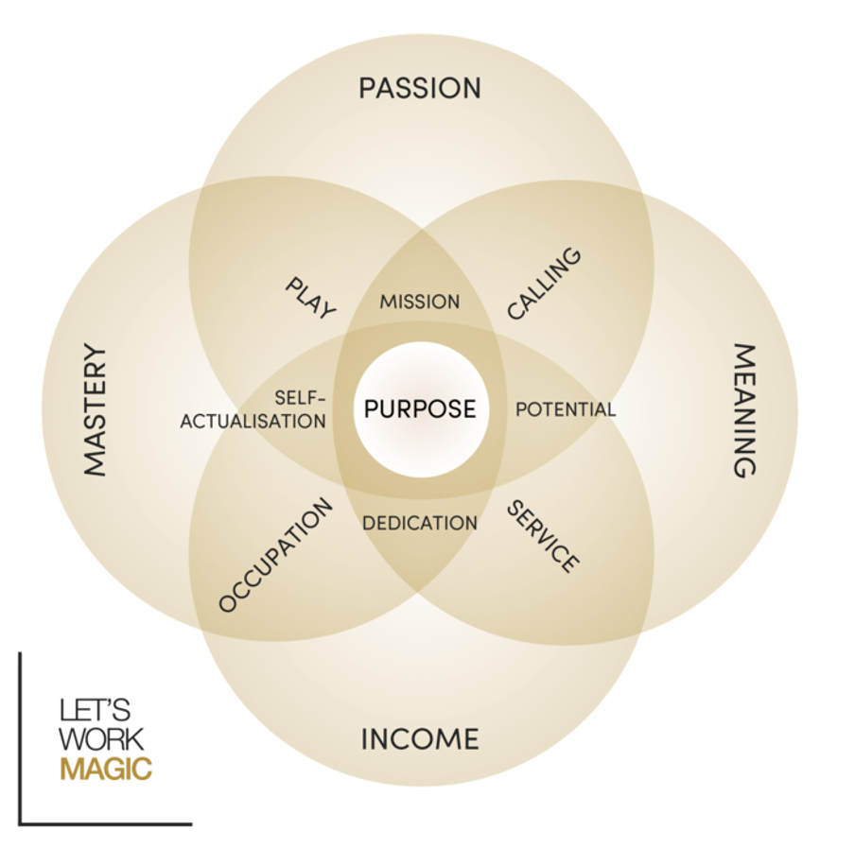

Slide 3


Slide 4

CONSIDER YOUR PERPOSE
WHAT IS YOUR WHY?

Slide 5


Slide 6
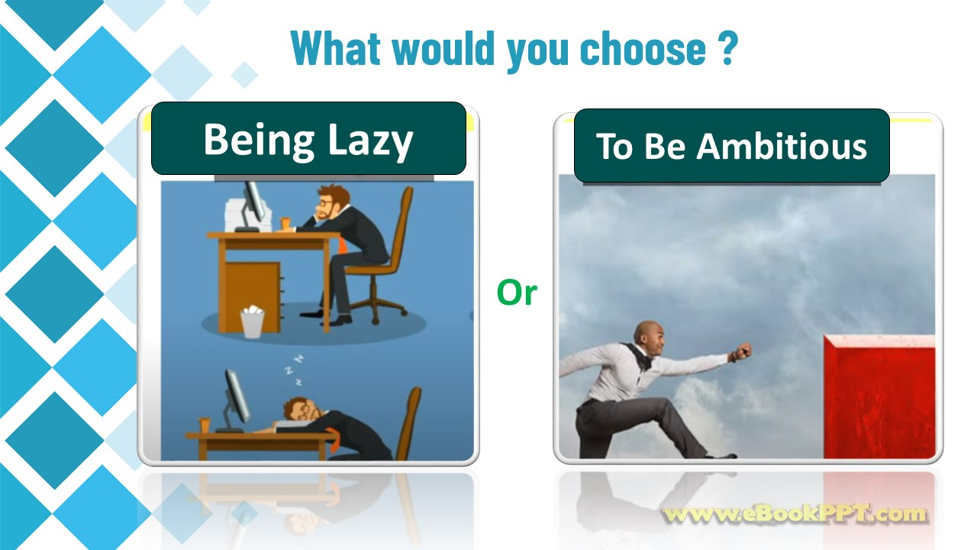

Slide 7
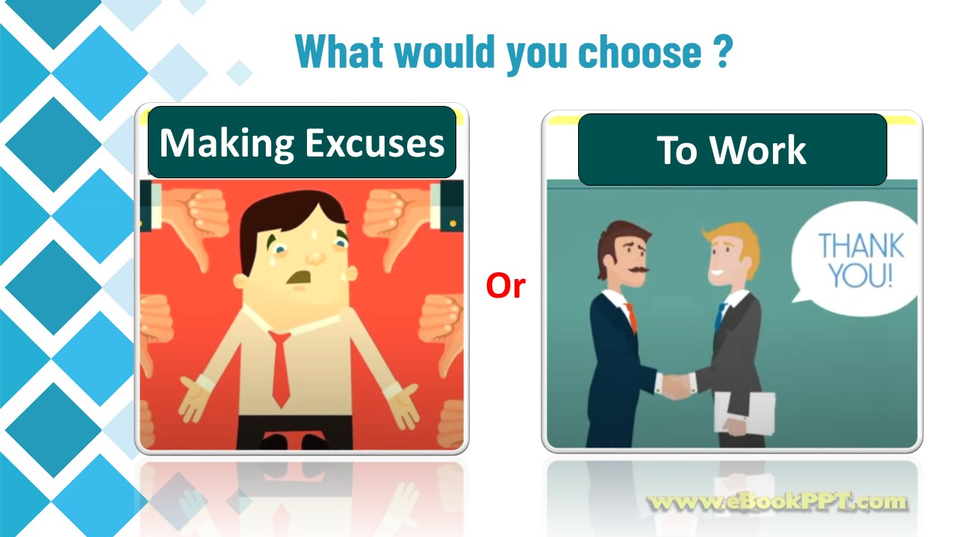

Slide 8


Slide 9
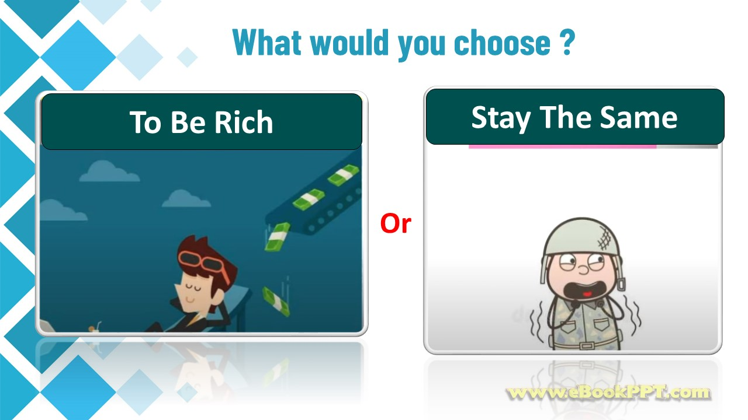

Slide 10


Slide 11
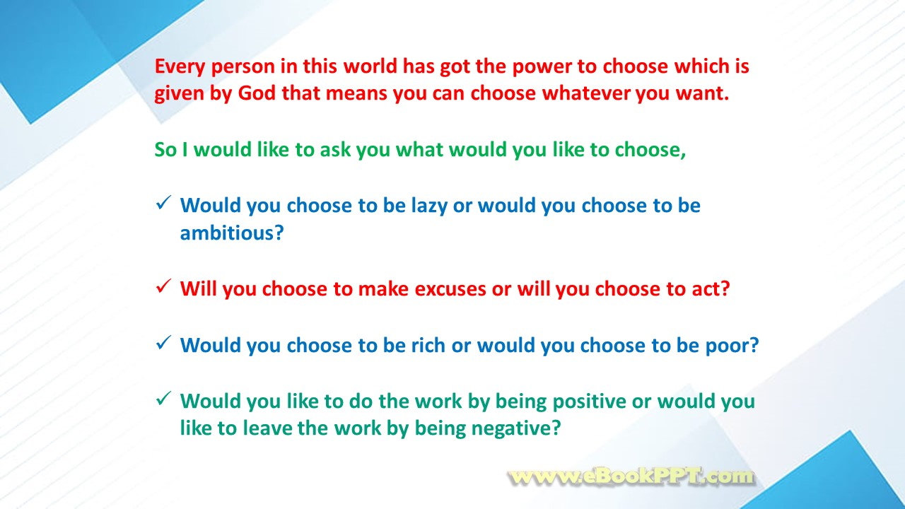

Slide 12


Slide 13


Slide 14
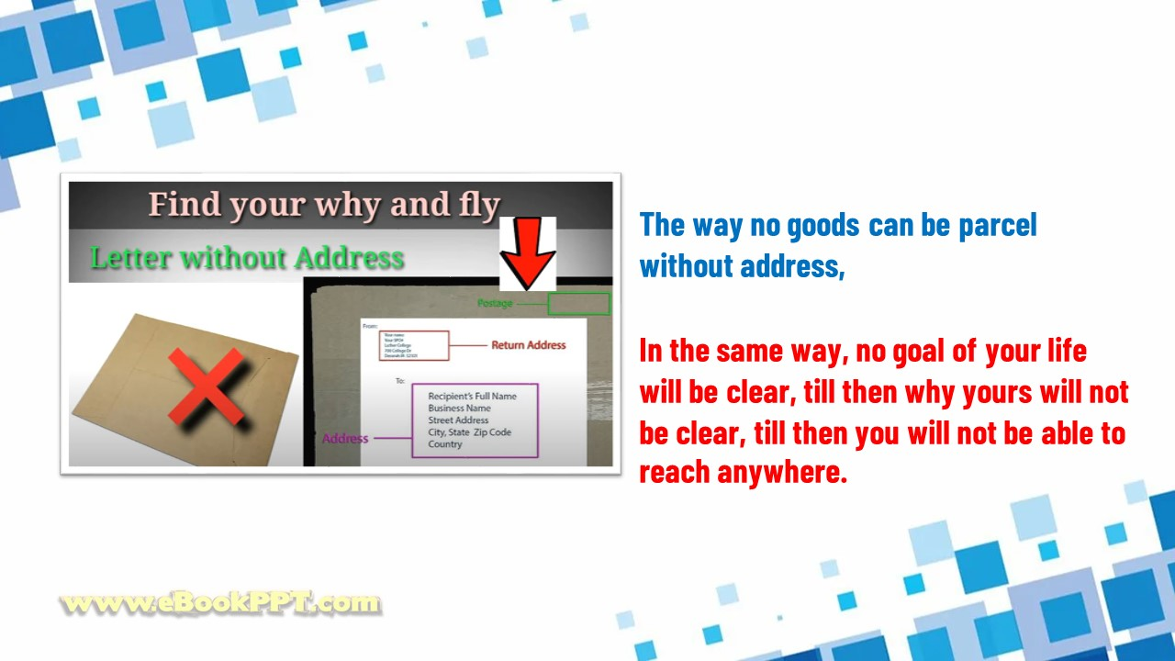

Slide 15


Slide 16


Slide 17


Slide 18


Slide 19



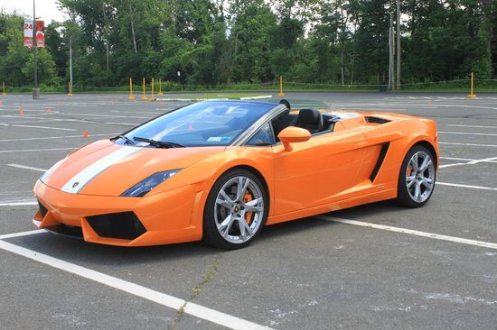


SML GOAL
SHORT TERM | MID TERM | LONG TERM
1. | 1. | 1.
2. | 2. | 2.
3. | 3. | 3.
4. | 4. | 4.
5. | 5. | 5.

Slide 20


Slide 21


Slide 22

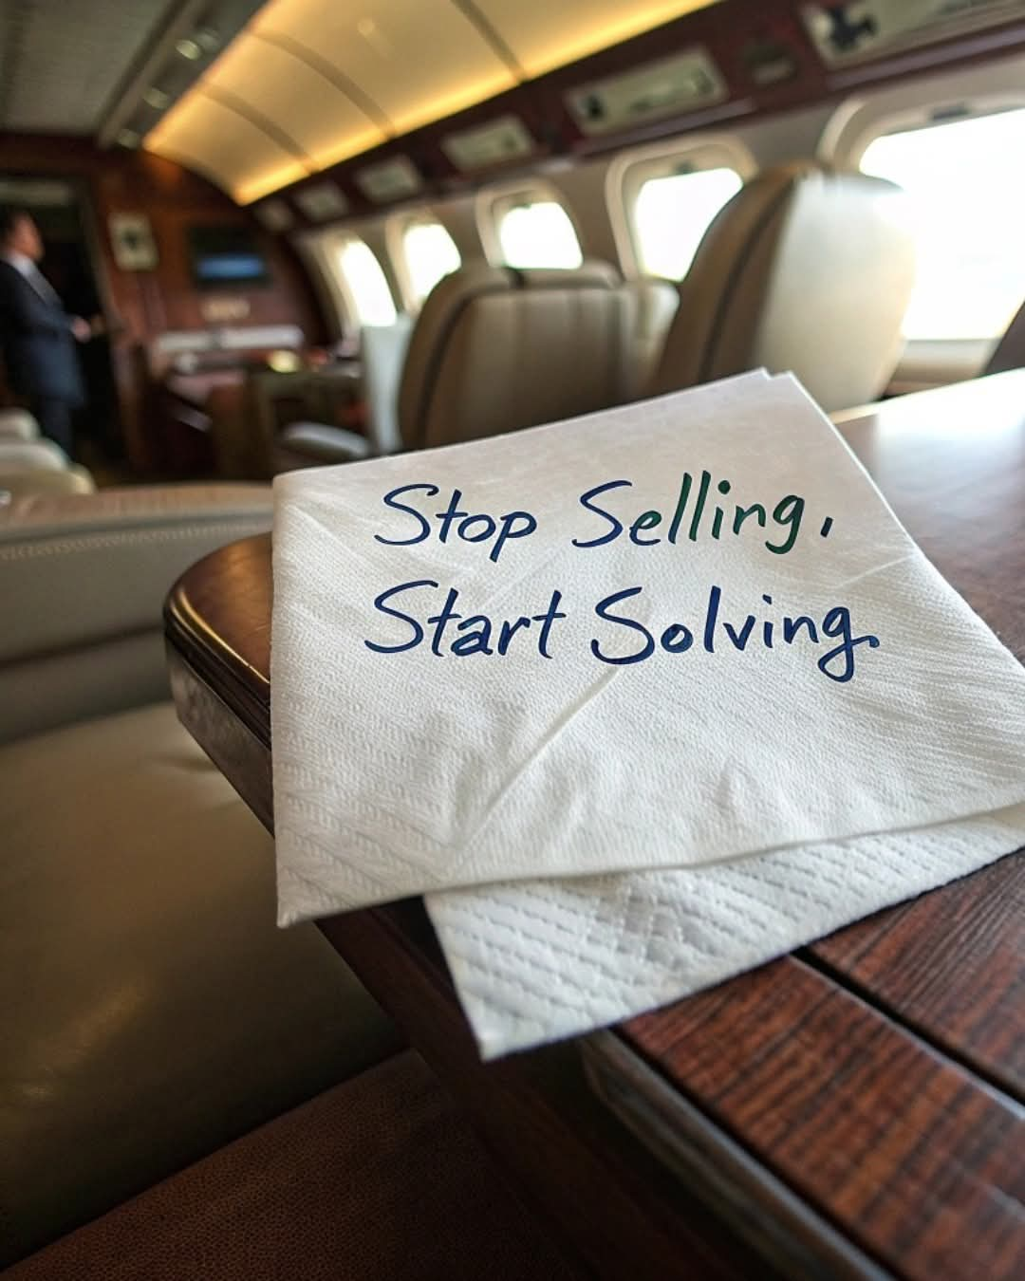
People don't buy products. They buy solutions to their problems.

Slide 23
UNDERSTAND YOUR TARGET AUDIENCE
THEIR PAIN POINTS OF NEED.
HOW YOUR PRODUCT AND SERVICES CAN SOLVE THEIR PROBLEMS.
HOW YOU CAN BUILD RELATIONSHIP AND TRUST WITH THEM.

Slide 24
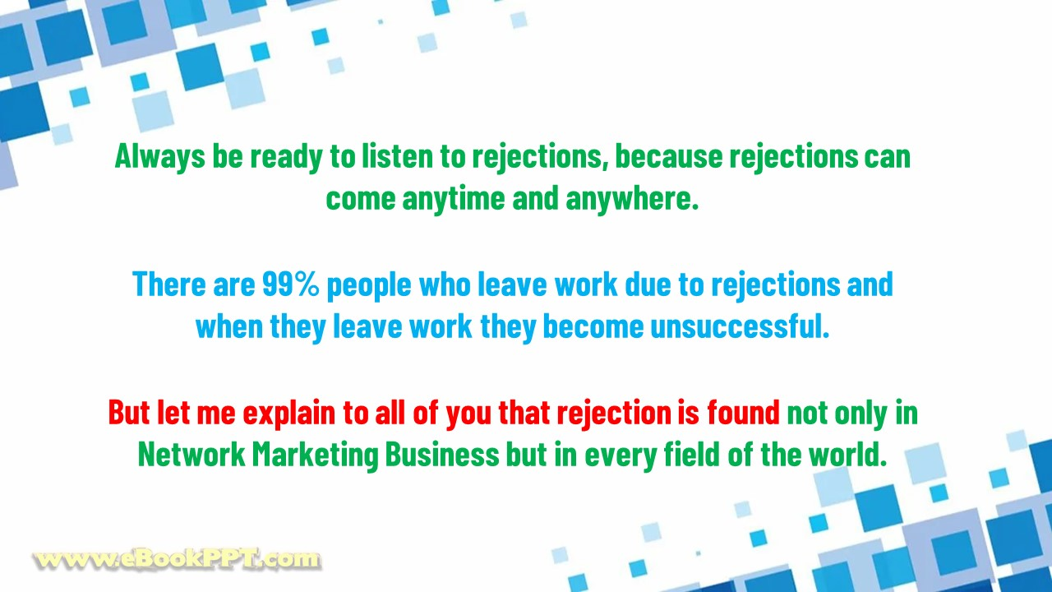

Slide 25


Slide 26

SW 5 RULES
SOME WILL COME
SOME WILL NOT COME
SO WHAT
SOMEONE IS WAITING
SO START WORK

Slide 27


Slide 28
WHY PEOPLE FAIL IN DIRECT SELLING.
LACK OF CLARITY.
NO DAILY ACTION PLAN
WEAK MINDSET AGAINST REJECTION
INFLUENCE OF NAGATIVE PEOPLE.

Slide 29
LESSON
CLEARITY OF VISION
COMMITMENT OF CONSISTENT ACTION.
STRONG MINDSET TO HANDLE NEGATIVITY.
BUILD MENTAL IMMUNITY.
WHY INDUCTION IS CRUCIAL
YOUR MINDSET DEFINES YOUR SUCCESS.
( YOUR THOUGHTS DECIDE YOUR ACTIONS, YOUR ACTIONS DECIDE YOUR INCOME.)

Slide 30


Slide 31

START A NEW HEALTHY HABIT

Slide 32


Slide 33

PROTENTIAL+PROCESS= GREATNESS

Slide 34
10 Best STEPS
Know & follow 8 steps success
10 call & 3 plan per day
Take presentation & training
Always ready to give testimony
100% user
Attend all function
Read recommended book 30 min everyday
Team player
Always keep two business kit with you.
Keep all promotional material from system

Slide 35


Slide 36
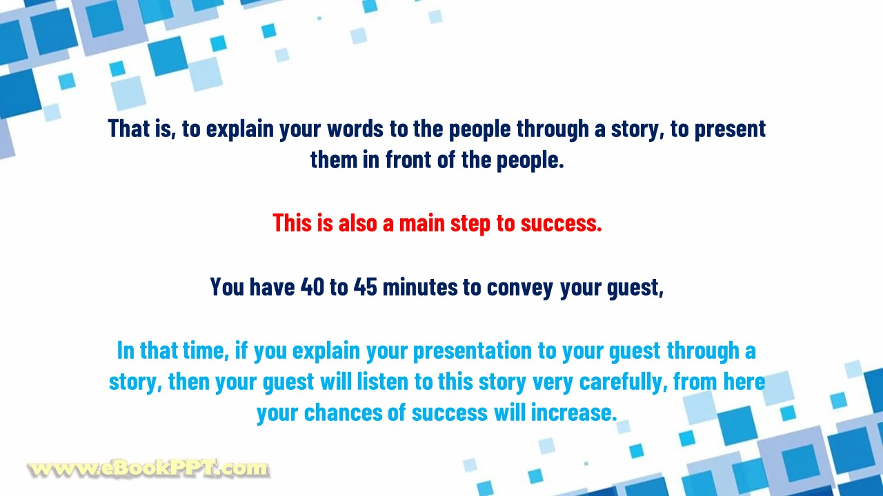

Slide 37


Slide 38


Slide 39


Slide 40


WORK WITH TEAM, NOT ALONE

Slide 41
Your relationships in the network
When you are in the sponsor's place:
Never promote business by falling down
Do not say that you will get a lot of money without doing anything
I will work you will earn money. It is absolutely wrong to say so.
Don't make false promises
Hiding Some Information Can Hurt You
Don't force a decision on your invitation
Don't spend money on anyone's joining.
Talk straight
Don't show too much

Slide 42
If you are downline
If your upline (in time of need) seeks you out then you are on the right track.
Extend your hand, help and keep the promise made to work.
Respect the lessons you learn from your upline
Do regular counseling
Always be honest with every upline
Be Teachable
Take care of your health
Learn to laugh
If you can't speak well then keep quiet
Refrain from commenting on something

Slide 43
When you are at the place of cross line..
Cross line is that part of the business which has its advantages as well as disadvantages.
Cross lines are like our cousins
Dealing with the cross line should be very simple, a loving smile, how to be lively and immediately let's meet again. ( Hello, Hi and Bye)

Slide 44


3 Cardinal Rules
  1. Never do any new thing without asking your active/successful Up Line.
  2. Never pass negative to Downline and Cross Line.
  3. Never ever play with family members / ego / money.

Slide 45

To do strong work you need to have a “Strong core Leader"
People are being recruited but are they becoming leaders?
If we do core training every month then….
Together we have to make lakhs of commandos in the team.

Slide 46
Process Flow
LIST
CORE TRANING
PLAN
FIM
FOLLOW UP

Slide 47


Thank You So Much

