Slide 1

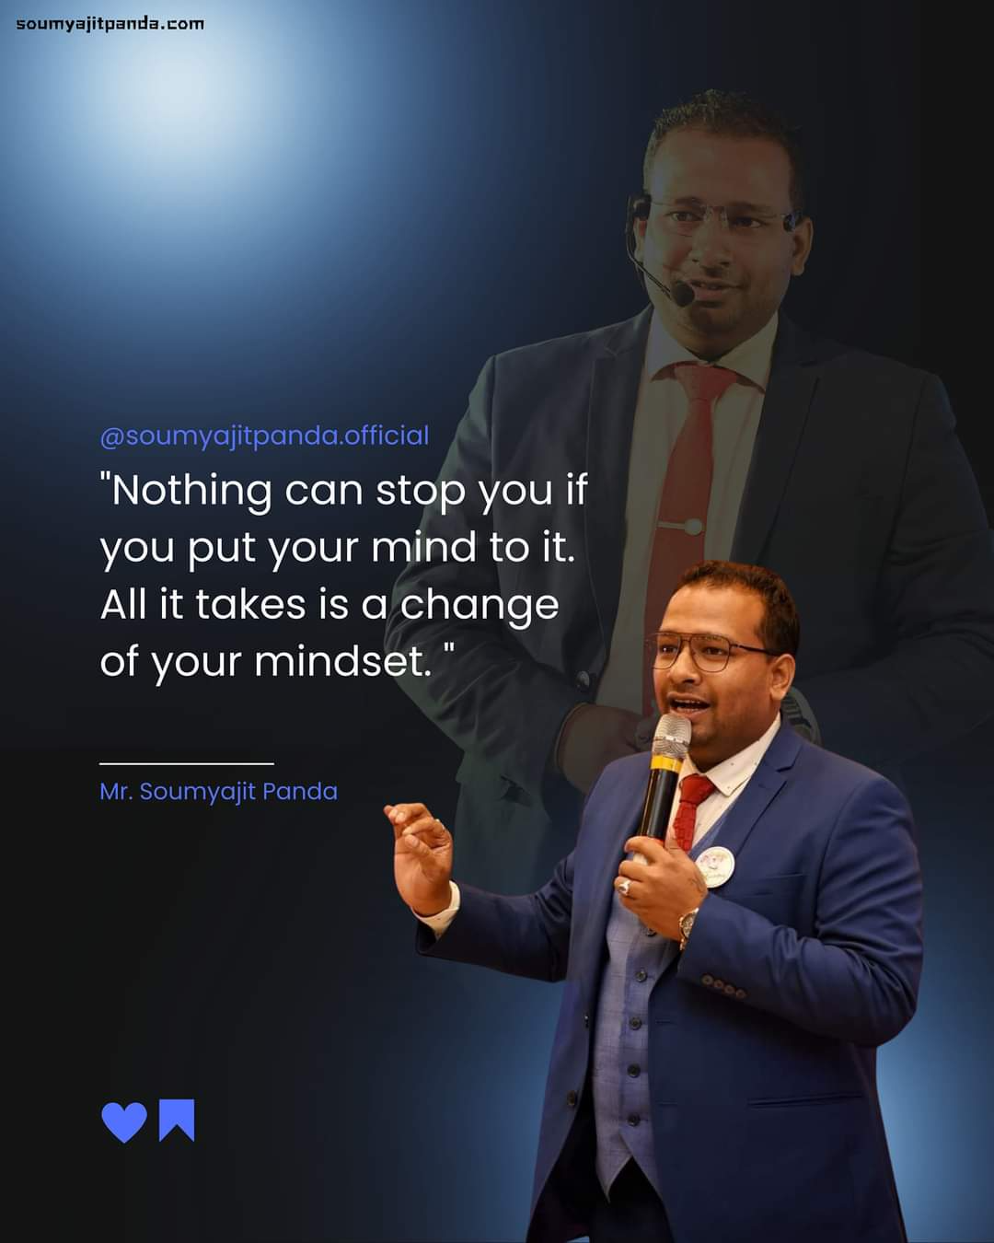

HOW TO GROW YOUR 10X BUSSINESS.
RESTART YOUR BUSSINESS
By :SOUMYAJIT PANDA.
Notes:
This file is a complete editable file, here you can put your photo, logo and also write your name.

Slide 2



Slide 3
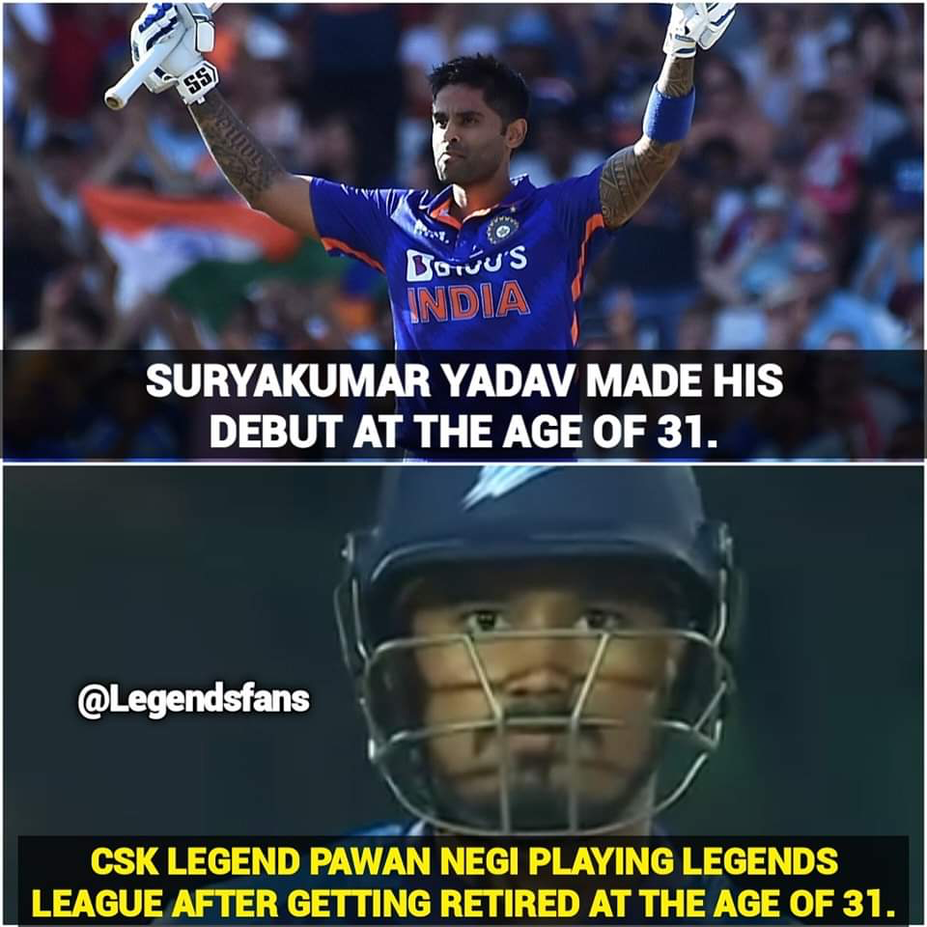

Slide 4

Essential Principles of Sales.
ENERGY+TIME+MONEY= SUCCESS
JAHA PAISE NEHI LAGTA YUHA ATTITUDE NEHI LAGTI.

Slide 5


Attitude

Slide 6

RE-EVALUATE AND REFOCUS.
REVISIT YOUR WHY.
ASSESS YOUR CURRENT SITUATION.
IDENTITY AREAS FOR IMPROVMENT.
RE EXAMINATION YOUR GOALS.
SEEK YOUR FEEDBACK.

Slide 7


Slide 8



Slide 9


Slide 10


Slide 11
PRESENTATION
. Establish Rapport.
Choose the Right Seating.
Set a Positive Tone
Begin with a Story
Introduce the Company
Highlight Products/Service

Slide 12
PRESENTATION
. Listen Actively
Agree With Your Prospect .
Keep it Simple Share Success Stories
Create Urgency
Offer Samples/Demos
Show Income Projections Offer Support Materials .
Close with Confidence

Slide 13
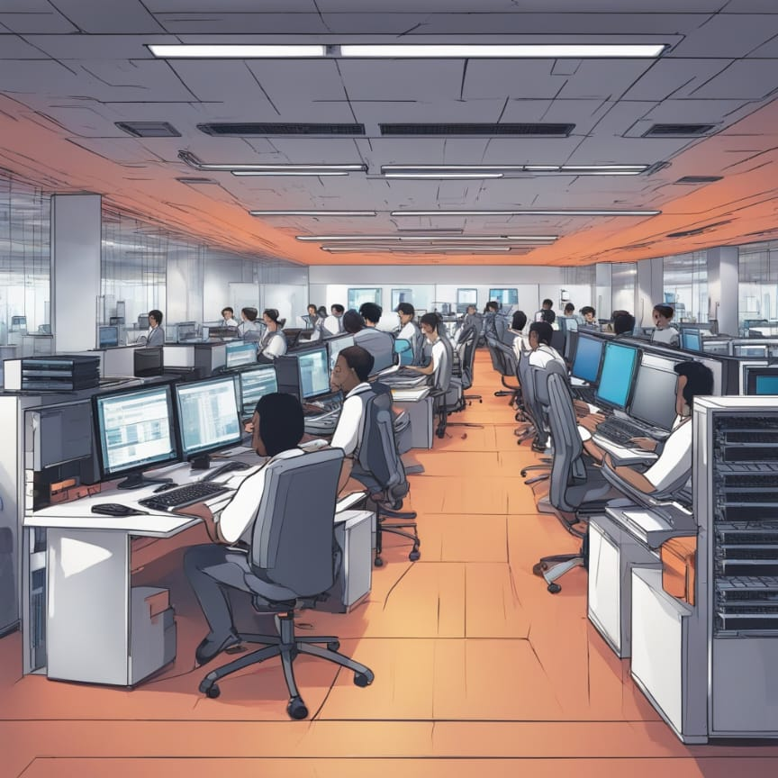
10 Best STEPS
Know & follow 8 steps success
10 call & 3 plan per day
Take presentation & training
Always ready to give testimony
100% user
Attend all function
Read recommended book 30 min everyday
Team player
Always keep two business kit with you.
Keep all promotional material from system

Slide 14
YOU NOT A SALES MEN
CONSULTANT
1.EXAMINATION
2 DIAGNOSE
3 TREATMENT.
FOCUS OF RELATIONSHIP
VALUE & TRUST

Slide 15
BUILDING A LIFE TIME IMPRESSION
N- NEED
I- INTEREST
C- CONCERN
E-EXPECTATION
1.CONVINCE
2.CONNECT
3.PROBLEM

Slide 16
3 STEPS TO CREAT SUCCESSFUL CLOSING
RIGHT BUSINESS AT THE RIGHT TIME.(MLM MARKETING IS ONE OF THE MOST DEMOCRATIC WAYS TO BECOME RICH.)
YOUR TRUTH & STORY (TELL YOUR EXPERIENCE AND FEELINGS HERE)
PROOF YOUR SERIOUSNESS AND PREPARATION.( YOUR KEY TO SALES CLOSING IS PERSONAL ASSURANCE.)

Slide 17
REMEMBER
COUTOMERS EXCUCE IS THE MAIN RESON TO DO THIS BUSINESS.

Slide 18
How to build a solid team
DEMONSTRATION OVER MOTIVATION
EARLY ACTIVATION OF NEW ASSOCIAT ( A) CONVERT NEW ASSOCIATE INTO TEAM WITH IN 2-4 WEAK. (B) BUSINESS SIMPLE HAY ASSAN NEHI
1 ASSOCIATE= 1 INDUSTRY.( TAKE CARE OF PEOPLE)
RESULTS FROM EVERY EVENT. ( EVERY MEETING MUST BE END WITH SPECIFIC MASSAGE)
POWER OF UNITY.

Slide 19
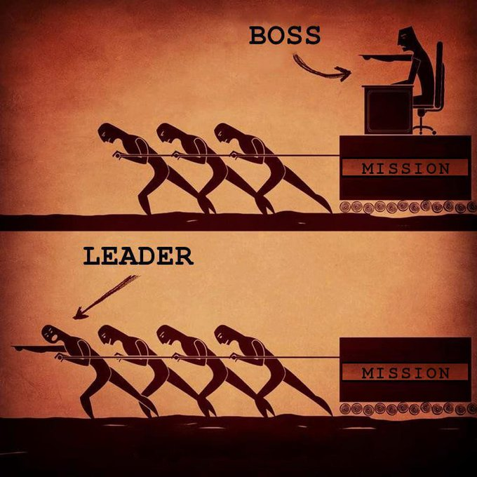
LEADERSHIP

Slide 20


To do strong work you need to have a “Strong core Leader"
People are being recruited but are they becoming leaders?
If we do core training every month then….
Together we have to make lakhs of commandos in the team.

Slide 21
DEVLOPMENT LEADERSHIP SKILL.
BECOME EXCELENT.( NO BODY FOLLOW AVEARAGE PEOPLE)
DEVLOP THE ART OF OBSERVATION.
LEARN MORE THEN OTHHERS IN YOUR FIELD. ( YOU HAVE TO LEARN TO BEST).
SELF ANALYSIS.
BE WITH OTHER LEADER.
COMMUNICATION SKILLS.

Slide 22



R E L A T I O N S H I P .
T O O L S .
P R O G R A M S .
M E E T I N G ,
R E V I E W S .
G E T T O G E T H E R .
G R O U P
M E E T I N G .
W O R K S H O P .
L E A D E R C R E A T I O N & T E A M B U I L D I N G
C E L E B R A T I O N

Slide 23


INCOME
=
NUMBER OF ACTIVE DISRIBUTOR

Slide 24

TAKE OFF SYSTEM
" D U P L I C A T I O N I S
E S S E N T I A L F O R S U C C E S S "
Y O U H A V E N O T R E A L L Y S P O N S O R E D A P E R S O N T I L L T H E T I M E Y O U M A K E
T H E M S P O N S O R S O M E O N E .

Slide 25

GOOD QUALITY OF LEADERSHIP
D E C I S I O N M A K E R
G O O D C O M M U N I C A T I O N
S E T T H E E X A M P L E
M O T I V A T E O T H E R S
A T T E N T I O N T O S U C C E S S

Slide 26


OPPORTUNITY.
DON'T WAIT FOR
CREATE IT.

Slide 27

BE POSITIVE THINK POSITIVE STAY POSITIVE

Slide 28


