Slide 1

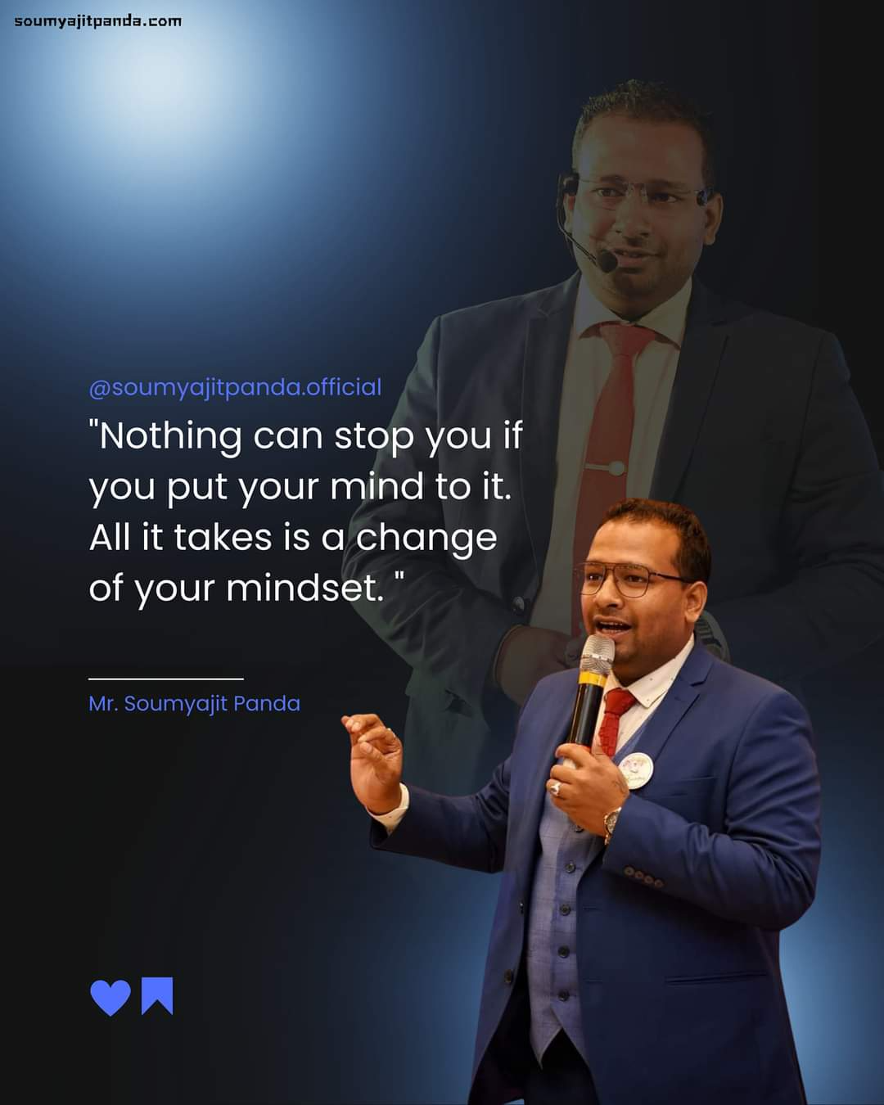


RESTART YOUR BUSSINESS
By :SOUMYAJIT PANDA.
Notes:
This file is a complete editable file, here you can put your photo, logo and also write your name.

Slide 2




Slide 3
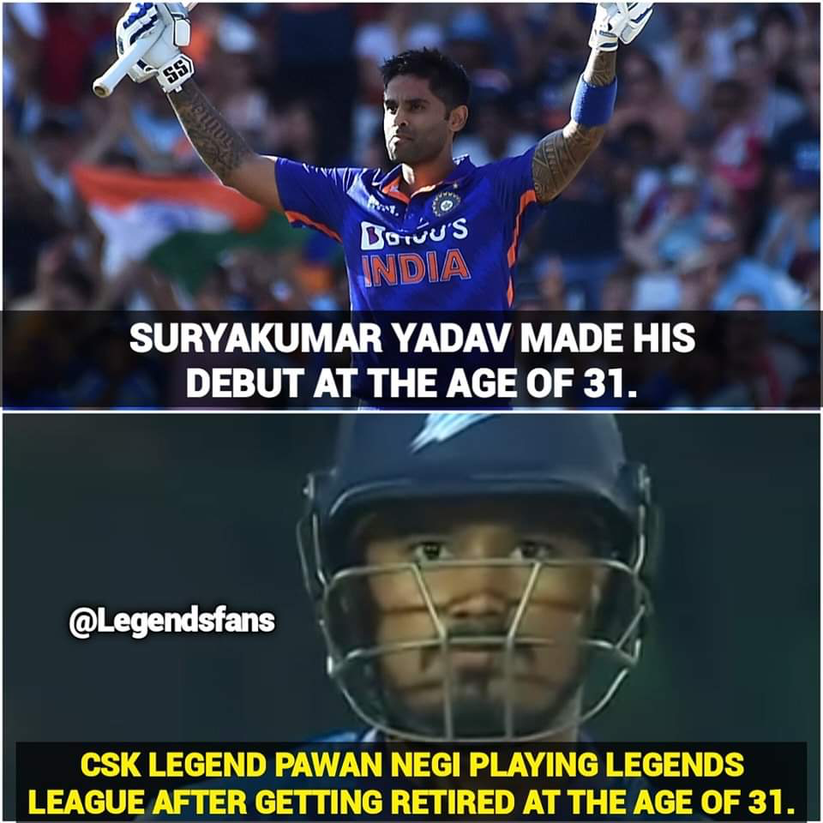

Slide 4

Essential Principles of Sales.
PRODUCT+PLAN+YOU= SUCCESS
JAHA PAISE NEHI LAGTA YUHA ATTITUDE NEHI LAGTI.

Slide 5


Slide 6

LEARNING IS THE KEY.
SYSTEM IS IMPORTENCE.
DATA ANALYSIS..
IDENTITY AREAS FOR IMPROVMENT..
LIST BUILDING.
THE POWER OF RETENTION

Slide 7
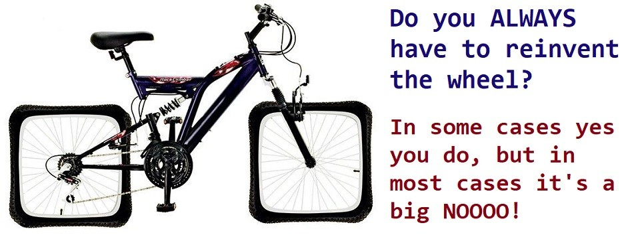

SYSTEM IS THE BOSS
THERE IS NO SECRET TO SUCCESS , THERE IS ONLY SYSTEM IS SUCCESS

Slide 8

PLUG YOUR PROPLE INTO THE SYSTEM, NOW SYSTEM WILL WORK FOR YOU.

Slide 9
DATA ANALYSIS.
THE MAGIC OF NUMBERS.
HOW MANY PEOPLE IN YOUR LIST.
HOW MANY FULL TIMER IN YOUR LIST.
HOW MANY GAUEST ATTEND IN YOUR PROGRAM EVERYDAY.
HOW MANY PIN ACHIVER TERGETING FOR NEXT MOUNTH.
HOW MANY PROGRAMME ARRENGE IN NEXT MOUNTH

Slide 10
DATA ANALYSIS
GUESTS | AUG. 50 | SEP 70 | OCT 100
PERSONAL SPONSOR. | 3 | 5 | 7
DAILY PLAN. | 3-4 | 7-8 | 9-10
FULL TIMES. | 5 | 7 | 10
PRESENTERS | 6 | 10 | 18
NEW PIN ACHIVERS | 4 | 7 | 10
THE BACK BONES OF SUCCESS

Slide 11
IF YOU WANT TO IMPROVE YOUR CHEQUE, JUST IMPROVE YOUR NUMBERS
IF YOU KNOW YOUR NUMBERS AND IF YOU IMPROVE YOUR NUMBERS, YOU DEFINETDLY MOVING FORWORD AND GROWING BUSINESS

Slide 12


INCOME
=
NUMBER OF ACTIVE DISRIBUTOR

Slide 13


TAKE OFF SYSTEM
" D U P L I C A T I O N I S
E S S E N T I A L F O R S U C C E S S "
Y O U H A V E N O T R E A L L Y S P O N S O R E D A P E R S O N T I L L T H E T I M E Y O U M A K E
T H E M S P O N S O R S O M E O N E .

Slide 14
Benefits of making a list
If you start earning 1,00,000/- per month in a year, can you make a list?

Slide 15
How to make list
L - LARGE
I - INTERACTIVE
S - SPECIFIC
T - TRIAL

Slide 16

How to Make list
You can also add all the numbers in your phone book to the list.
You can also make a list with FRIENDS technique
F - FRIENDS
R - RELATIVE
I - Institutions
E - EDUCATIONAL FRIENDS
N - NEIGHBOURS
D - DAY TO DAY FRIENDS
S - STRANGERS

Slide 17

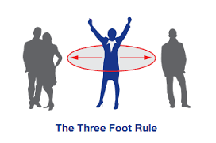
THE THREE FEET RULE
( Approach everyone near you )

Slide 18
THE POWER OF RETAINTION
RECRUITING IS EASY , RETENTION IS MASTERY.
( 75% PEOPLE QUIT THIS BUSINESS IN JUST 72 HOURS.)

Slide 19

GOOD QUALITY OF LEADERSHIP
D E C I S I O N M A K E R
G O O D C O M M U N I C A T I O N
S E T T H E E X A M P L E
M O T I V A T E O T H E R S
A T T E N T I O N T O S U C C E S S

Slide 20


OPPORTUNITY.
DON'T WAIT FOR
CREATE IT.

Slide 21

BE POSITIVE THINK POSITIVE STAY POSITIVE

Slide 22


