Slide 1

ROAD TO RETREAT

Slide 2

CONSIDER YOUR PERPOSE
WHAT IS YOUR WHY?

Slide 3
What is the definition of success????????
Success is always doing your best.

Slide 4
INTERNAL MOTIVATION
RIGHT GOAL SETTING
YOUR SELF YOUR GOAL.
TAKE A SCHEDULED BREAK.
WORK WITH SUPPORT GROUP.
DAILY PROGRESS TRACKERS.
KEEP ADD WORK DAILY ROUTINE.
WORK WITH A COACH
PLANS, THAT PLAN FAILS… (NEED A BACKUP PLAN)

Slide 5


Slide 6
YOU NOT A SALES MEN
CONSULTANT
1.EXAMINATION
2 DIAGNOSE
3 TREATMENT.
FOCUS OF RELATIONSHIP
VALUE & TRUST

Slide 7
BUILDING A LIFE TIME IMPRESSION
N- NEED
I- INTEREST
C- CONCERN
E-EXPECTATION
1.CONVINCE
2.CONNECT
3.PROBLEM

Slide 8


Slide 9


HOW TO CLOSING

Slide 10
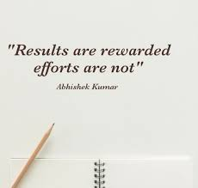


Slide 11
People buy from whom , they like and trust.

Slide 12
6 Proven Ways to Close More Sales in Network Marketing
#1 Magic Words
#2 Point out Similarities
#3 Smile
#4 Eye Contact
#5 Yes Stack
#6 Head Nod
Wishing you lots of happy closings!

Slide 13
3 STEPS TO CREAT SUCCESSFUL CLOSING
RIGHT BUSINESS AT THE RIGHT TIME.(MLM MARKETING IS ONE OF THE MOST DEMOCRATIC WAYS TO BECOME RICH.)
YOUR TRUTH & STORY (TELL YOUR EXPERIENCE AND FEELINGS HERE)
PROOF YOUR SERIOUSNESS AND PREPARATION.( YOUR KEY TO SALES CLOSING IS PERSONAL ASSURANCE.)

Slide 14
REMEMBER
COUTOMERS EXCUCE IS THE MAIN RESON TO DO THIS BUSINESS.

Slide 15
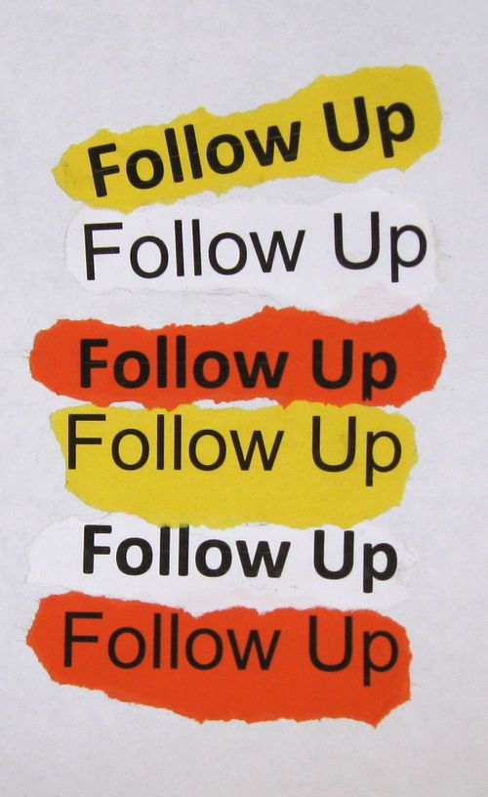

Slide 16
MLM IS YOUR BUSINESS…………………
YOU ARE YOUR BUSINESS.
YOU PROMOTE YOUR SELF, NOT ANYTHING ELSE.
YOUR SOCIAL MEDIA PROFIL MUST TALK ABOUT YOU ONLY.

Slide 17



Slide 18
AT LAST AS A sr ELITE, IT’S MY REQUEST & ADVISE………
BE FOCUSED
BE ACTIVE
BE SERIOUS
BE PLANER
BE THINKER
BE HONOUR

Slide 19
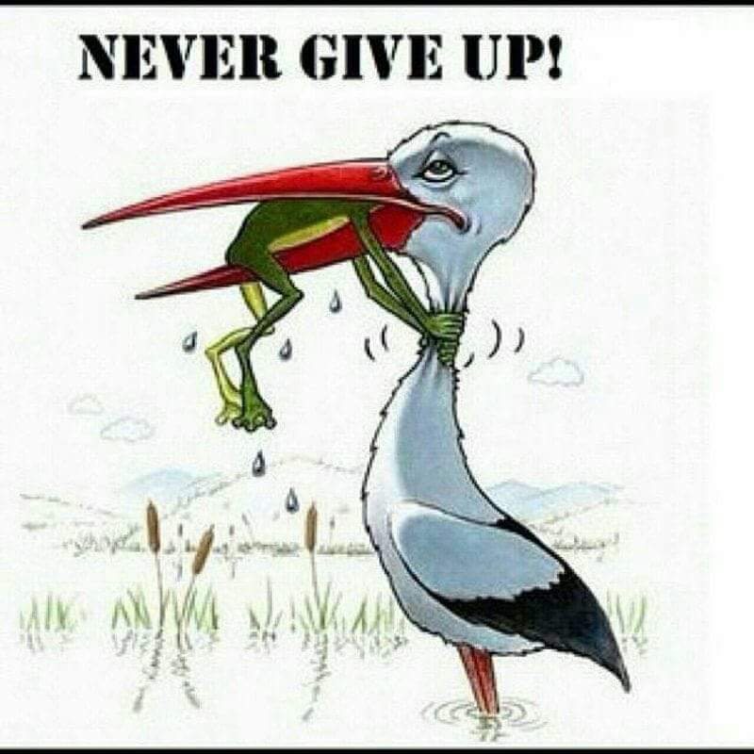
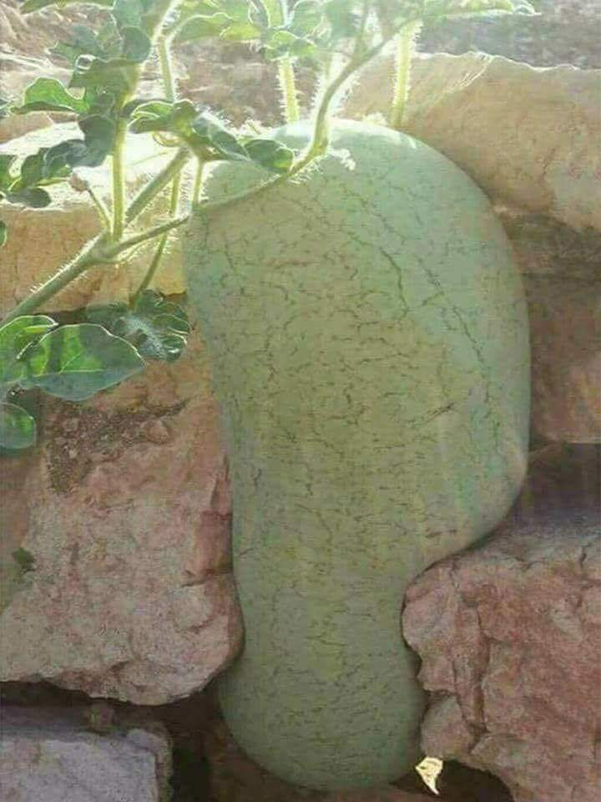

Slide 20

THANK YOU

Slide 21


